Slide 1
The New Croft Facility
Run by Haverhill Community Sports Association Ltd
More than just a Football Club……

Slide 2
The New Croft Facility is……
Whether you are looking for a small quiet room in which to hold your next board meeting or a spacious suite in which to hold a sales conference, The New Croft can accommodate your event.
All of our rooms are fully equipped with AV equipment and complimentary wireless internet access so we can create the perfect business experience from start to finish.

Slide 3
The New Croft is perfect for business:
  Conferences
  Meetings
  Training Courses
  Breakfast Seminars
  Business Lunches
  Exhibitions
  Team Building Events
  Awards Evenings
  Staff Parties
  Interviews

Slide 4
The New Croft is also perfect for leisure:
  Discos
  Children’s Parties
  Sports Parties
  Special Birthday Celebrations
  Weddings
  Group meetings
  Groups AGMs
  Exercise classes

Slide 5
The Bar Area

Slide 6
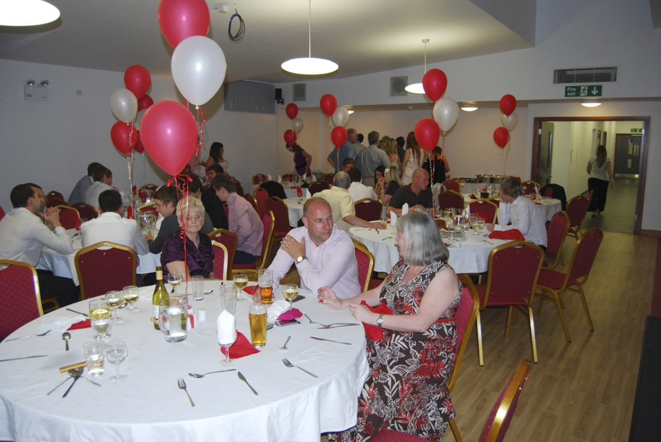
Large Multipurpose Area

Slide 7
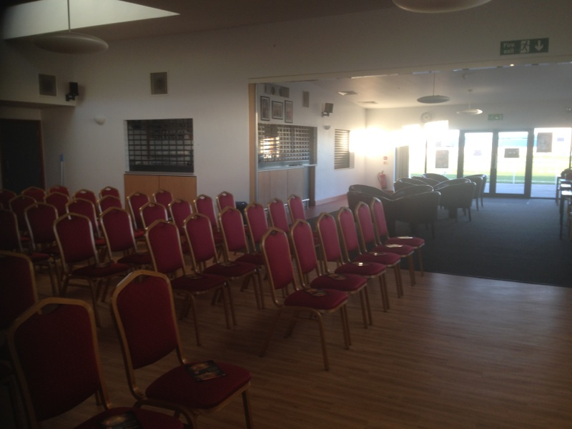
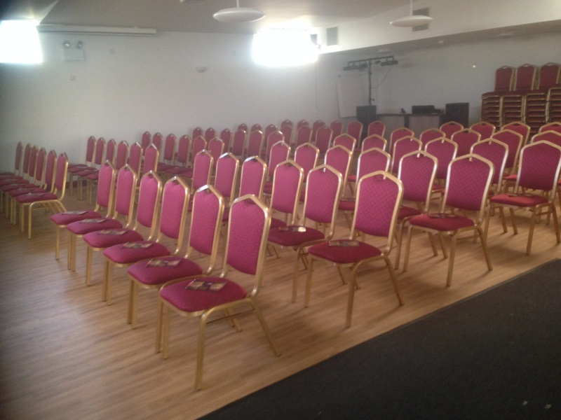
The Main Areas Open Together

Slide 8
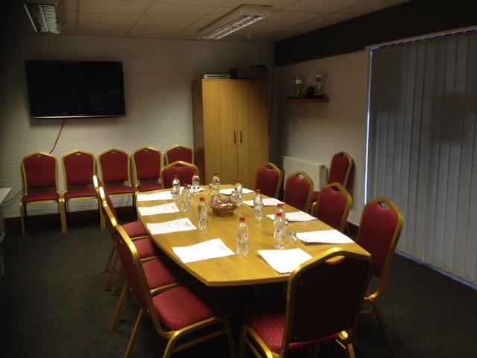
The Committee Room

Slide 9
Outside Areas

Slide 10
Catering from The New Croft Kitchen
The New Croft Kitchen produces quality food using locally sourced products wherever possible. We use natural, fresh ingredients and use our extensive culinary expertise to produce consistently great tasting platters of food for any occasion.
We cater for parties or events of virtually any size and will deliver to your property within 24 hours of receiving your order.
We're based in rural Suffolk and there's no delivery charge for orders taken within a 10 mile radius of the kitchen, and only a nominal charge to cover the cost of getting to you if you're a little further afield.
We have a 5-star food hygiene rating, use local suppliers and ingredients wherever possible and can cater for business meetings, picnic lunches, family celebrations or any event you can think of.

Slide 11
Full Catering Details and Menus
For full details and menu options click on this link:
The New Croft Kitchen Menus

Slide 12
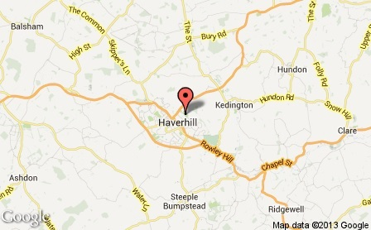
Contact Details
To book your event contact Peter Betts
Facility: 01440 702137
Peter: 07539 229114
For all your catering needs contact Fiona Tokley
Facility: 01440 702137
Fiona: 07951 722034
Location:
The New Croft
Chalkstone Way
Haverhill
Suffolk
CB9 0BW

